Slide 1
Arduino Bluetooth Workshop
By IEEE

Slide 2
Agenda
Introduction to Bluetooth
Using Bluetooth with an Arduino
Practice Time

Slide 3

What is Bluetooth?
Famous Short Range Communication / Data Transfer Technology
Commonly found in mobile phones, computers and other electronic devices
Many versions:
1.0, 1.1, 1.2 … 3.0, 4.0 (LE), 4.1, 4.2, 5.0

Slide 4
Bluetooth Concepts
Great Intro:
https://learn.sparkfun.com/tutorials/bluetooth-basics/all
Each Bluetooth Device has a unique MAC Address
Connection Process: Refer to link above!
Bluetooth Profiles:
Serial Port Profile (SPP)
Human Interface Device (HID)

Slide 5
Applications in robotics / Engineering
Wireless Control in short-range (E.g. Android Bluetooth Controller App)
Automated Wireless Data Communication between Devices (E.g. Swarm Unit)
Mesh Network (E.g. Beacons for position tracking)
Wireless collection of data from sensors

Slide 6
Bluetooth With Arduino
BUILT IN VARIANTS | ARDUINO COMPATTIBLE MODULES
BLEduino | HC-05
ATmega328-BT | HC-06
Arduino Bluno
Arduino Primo

Slide 7
The HC-05 Bluetooth Module
Bluetooth 2.0 + EDR (Enhanced Data Rate)
Implements a SPP (Serial Port Profile)
Can be both master and slave

Slide 8
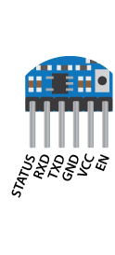
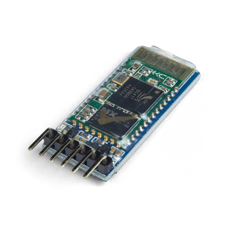
The HC-05 Bluetooth Module
VCC : Standard Power (3.3v)
GND : Ground
RX : Receive
TX : Transmit
EN : Key
STATE: LED

Slide 9
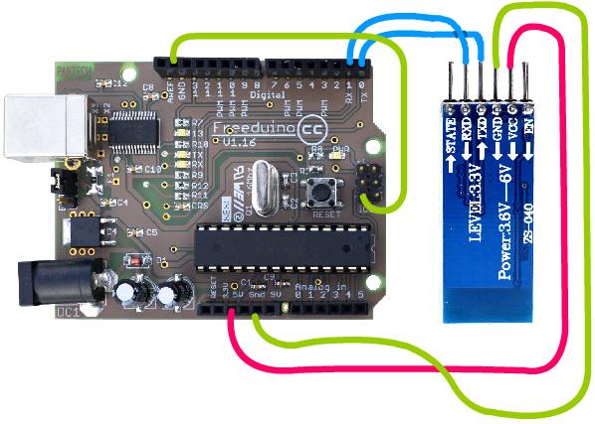
The HC-05 Bluetooth Module
How to configure?
Connect as shown
RX to RX; TX to TX !
Enter AT-Mode by setting EN Pin to HIGH (5V)
Use Serial Monitor on Arduino IDE (SHIFT + CTRL + ‘M’)
Baud Rate: 38400; Use ‘Both NL and CR’
LED on HC-05 should blink 1 / 2s

Slide 10
AT-Mode for HC-05 (Basic Commands)
Command | Response | Parameter
AT | OK | NONE
AT+NAME=<PARAM> | OK | Param: Bluetooth device name Default: “HC-05”
AT+NAME? | +NAME: <PARAM> OK----success 2. FAIL----failure
AT+PSWD=<PARAM> | OK | Param: Pin Code Default: “1234”
AT+ PSWD | + PSWD ：<Param> OK

Slide 11
How to Use After Configuring?
Swap these
Remove this
The Bluetooth module will simply act as a serial connection to the device its connected to.
Swap RX and TX wires
Remove wire from GND to Reset
Baud Rate: 9600
Use Serial.read() / Serial.write()
Refer to ‘Bluetooth_Switch.ino’

Slide 12

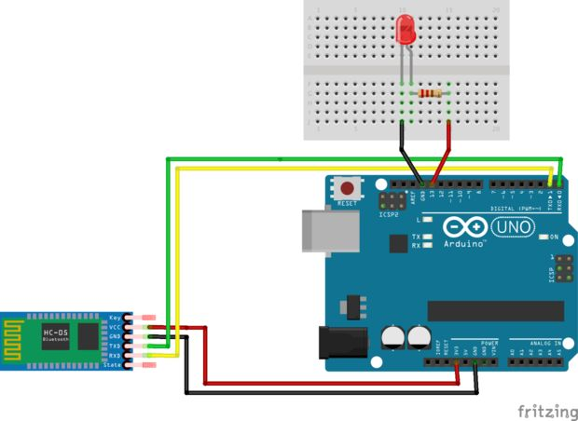
Schematic to control an LED
Connect as shown

Slide 13
How to Connect to the HC-05
Through phone
Download ‘Arduino Bluetooth Control’
https://play.google.com/store/apps/details?id=com.app.control&hl=en
Through PC
http://www.collideabq.com/2016/04/28/bluetooth-serial-connection-with-windows-10/
Use pyserial to communicate to Arduino via Python
Please refer to this in your free time

Slide 14
HC-05 through Phone
Connect to HC-05
Use Buttons Mode
Send data!

Slide 15
Try it yourself (30 min)
Play around with the different modes of sending data to the HC-05
Try and make a simple game to play between your phone and Arduino
Eg. A memory game?

Slide 16
Useful Links
Master and Slave: http://www.instructables.com/id/How-to-Configure-HC-05-Bluetooth-Module-As-Master-/
Bluetooth Controlled Projects: http://www.instructables.com/id/Bluetooth-Controlled-Projects/

Slide 17
THANK YOU ☺ SUTD IEEE STUDENT BRANCH

